Slide 1
UNIVERSITY OF PADOVA ________________________________________________________ MSc in Computational Finance Project: Yield Curve model calibration Ibrahim Uali Riccardo Caruso Enrico Berto Elisa De Colle ________________________________________________________ February 22, 2024

Slide 2
Index
The Nelson-Siegel and Nelson-Siegel-Svensson model
Gradient Descent method
Newton method
BFGS method
LM method

Slide 3
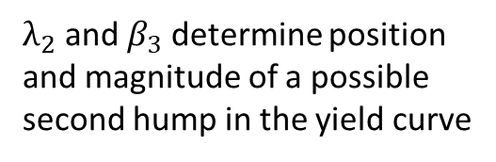
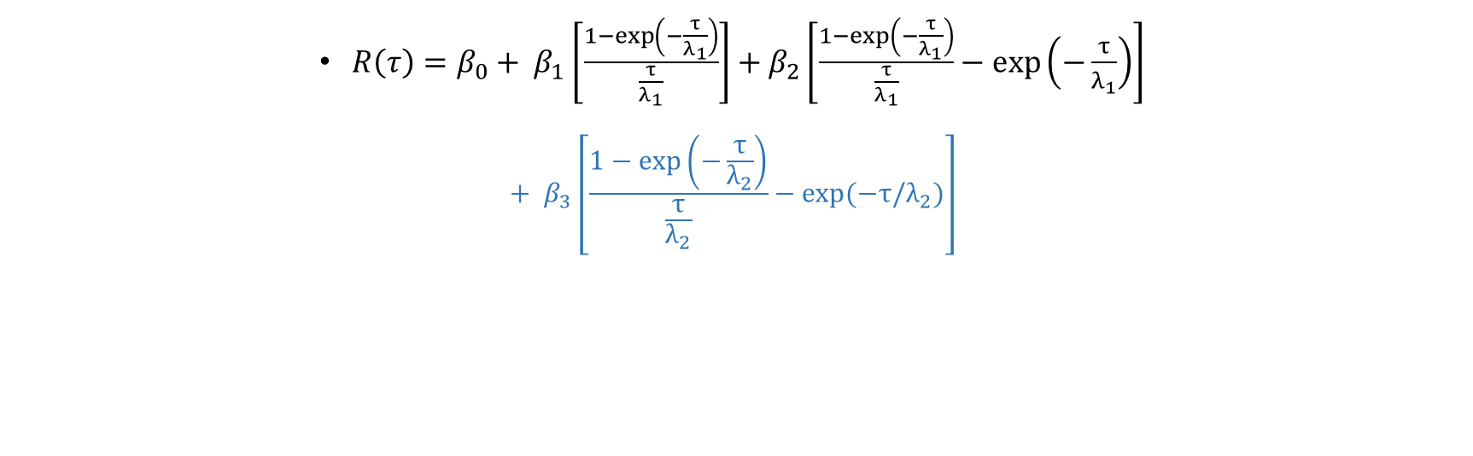
The Nelson-Siegel and Nelson-Siegel-Svensson
Spread
Degree of curvature
(first hump)
Long-term spot rate
${R\left(τ\right)=β}_{0}+ β_{1}\left[\frac{1−\exp\left(−\frac{τ}{λ_{1}}\right)}{\frac{τ}{λ_{1}}}\right]+β_{2}\left[\frac{1−\exp\left(−\frac{τ}{λ_{1}}\right)}{\frac{τ}{λ_{1}}}−\exp\left(−\frac{τ}{λ_{1}}\right)\right]$
$${+ β}_{3}\left[\frac{1−\exp\left(−\frac{τ}{λ_{2}}\right)}{\frac{τ}{λ_{2}}}−exp⁡(−τ/λ_{2})\right]$$
Location of the maximum/minimum of the curvature
$λ_{2}$ and $β_{3}$ determine position and magnitude of a possible second hump in the yield curve

Slide 4
The Project: Data Collection
1 year
2 years
3 years
5 years
10 years
US
Germany
Portugal
South Korea
BONDS
MATURITIES

Slide 5
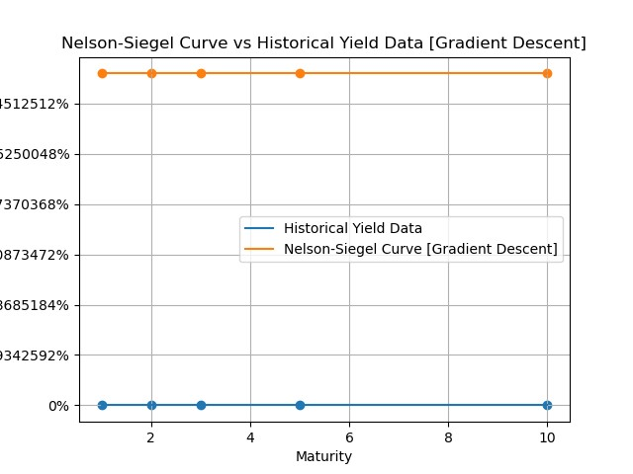
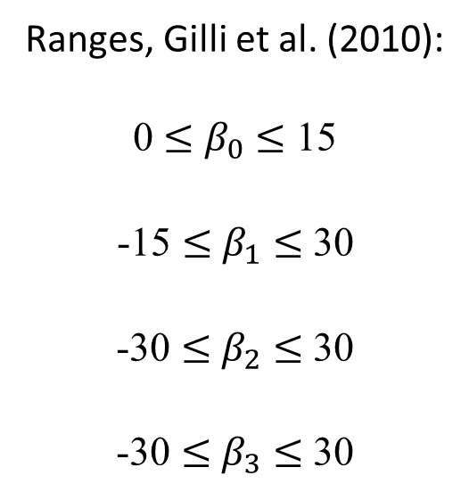
The Gradient Descent method
Initial parameters:
Ranges, Gilli et al. (2010):
0 $≤$ $β_{0}$ $≤$ 15
-15 $≤$ $β_{1}$ $≤$ 30
-30 $≤$ $β_{2}$ $≤$ 30
-30 $≤$ $β_{3}$ $≤$ 30
From these ranges we performed
several iterations in order to find the optimal initial combination. We did it be looking at the plots.
Example with all parameters set to 0.1

Slide 6
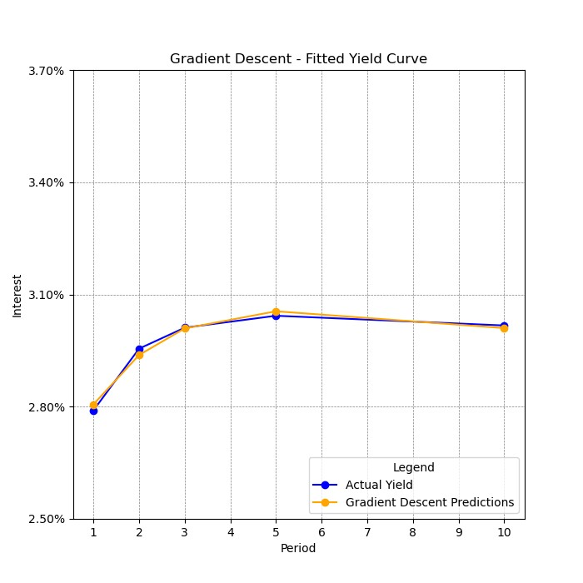
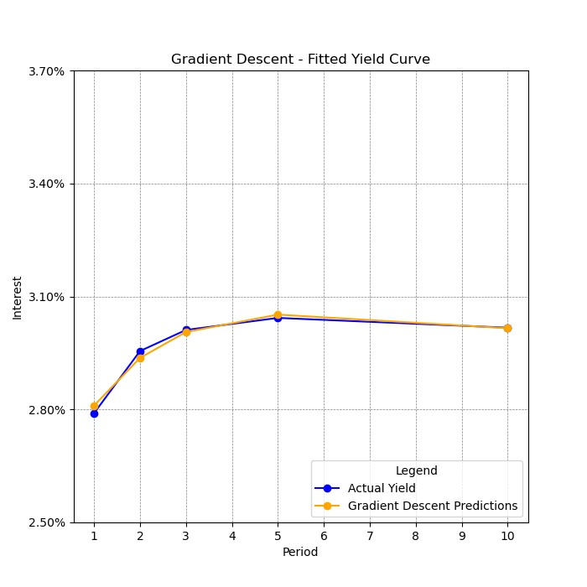
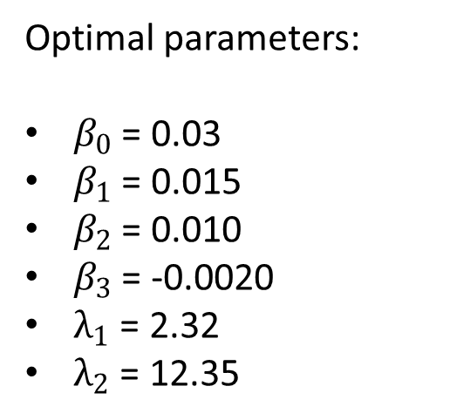
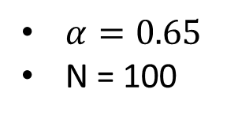
The Gradient Descent method
US:
We present the example of US. The behaviour of the Gradient Descent method is similar for every countries, but parameters and plots are different due to economic conditions.
Optimal parameters:
$β_{0}$ = 0.03
$β_{1}$ = 0.015
$β_{2}$ = 0.010
$β_{3}$ = -0.0020
$λ_{1}$ = 2.32
$λ_{2}$ = 12.35
$α=0.65$
N = 100

Slide 7
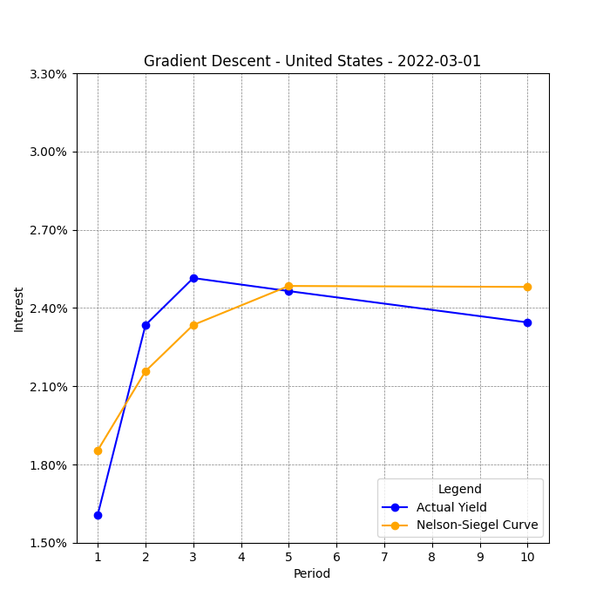
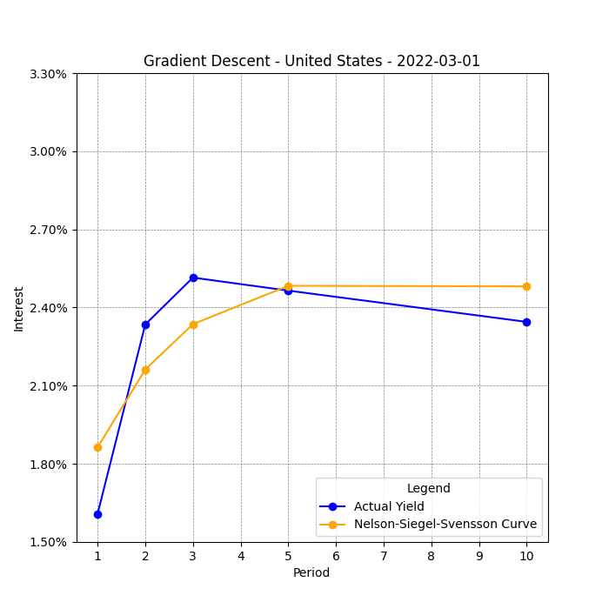
The Gradient Descent method
US:
Bonds with high volatility

Slide 8
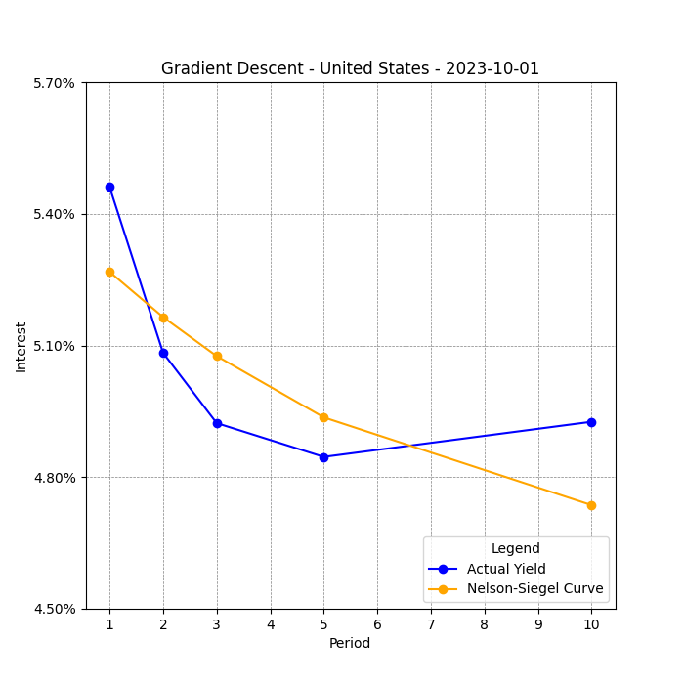
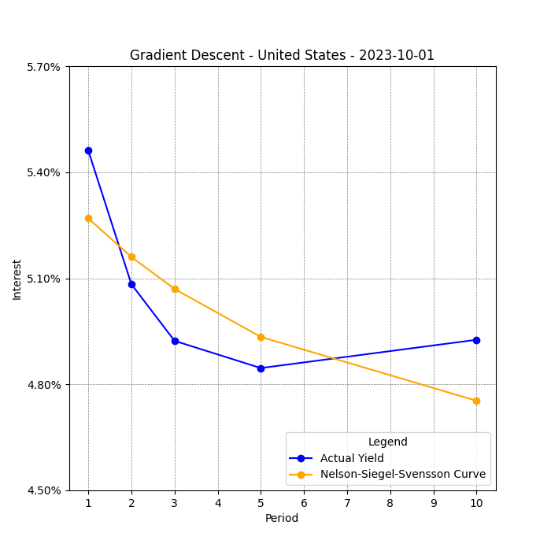
The Gradient Descent method
US:
Inverted yields curves

Slide 9
The Newton method
For each country we used the same vector of parameters for both Gradient Descent and Newton method
We have added a damping factor λ = 0,5 to ensure the Hessian is positive definite

Slide 10
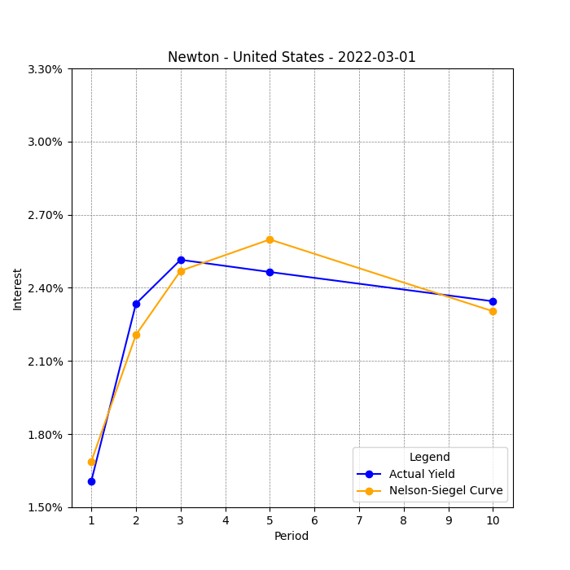
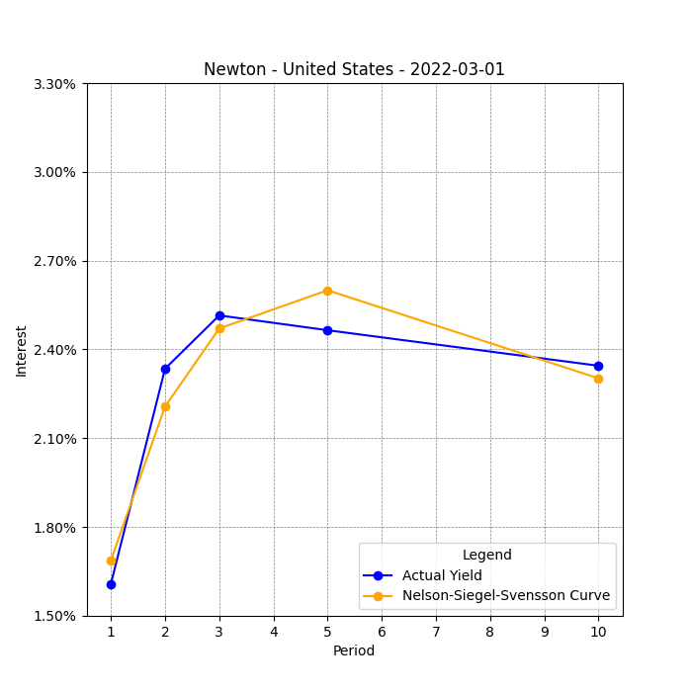
The Newton method
US:
Bonds with high volatility

Slide 11
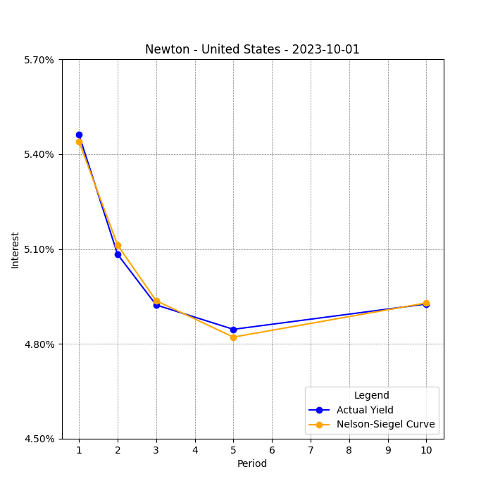
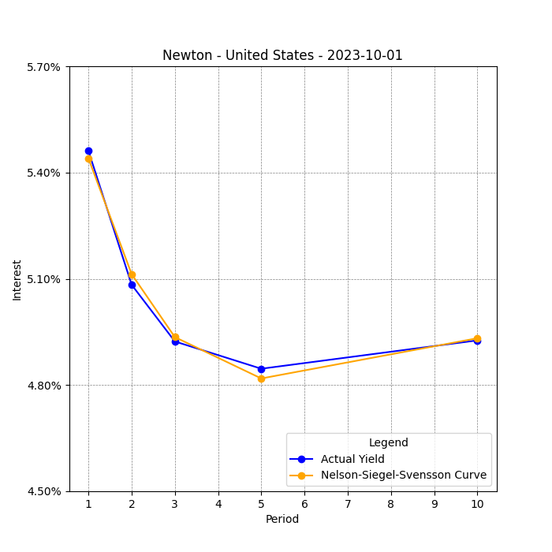
The Newton method
US:
Inverted yields curves

Slide 12
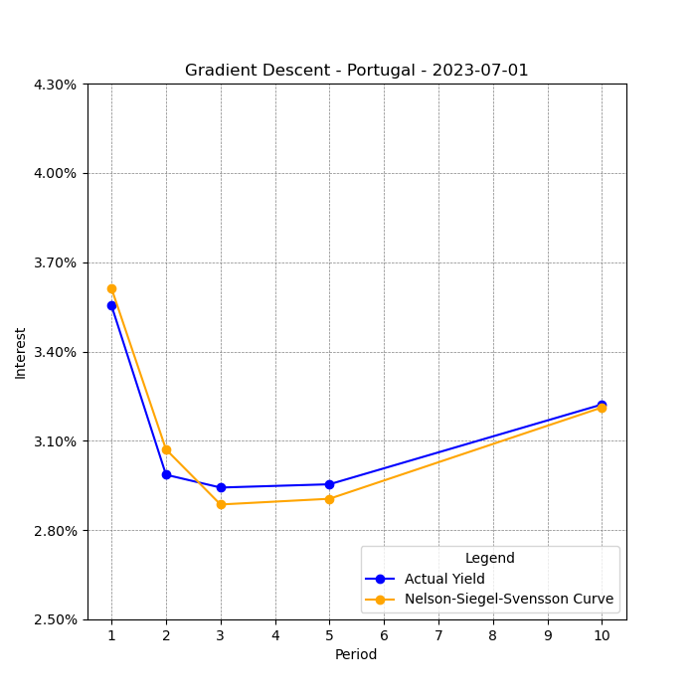
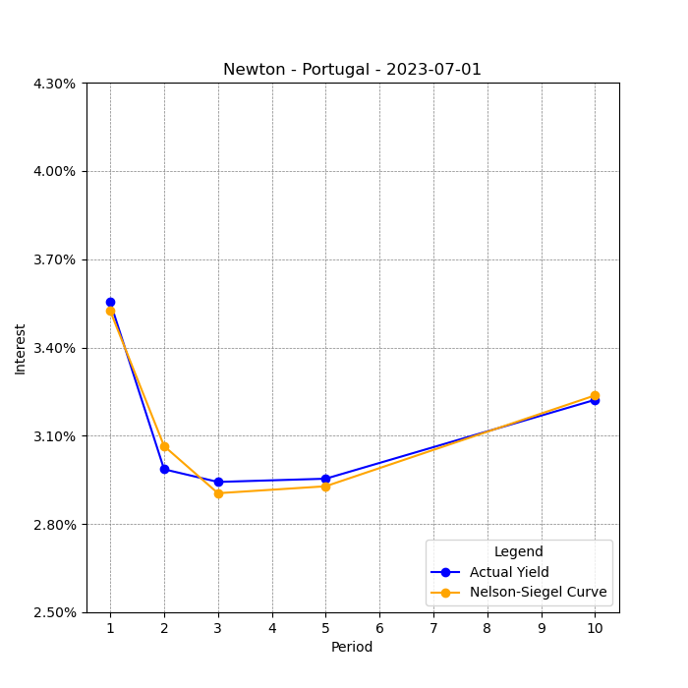
The Newton method VS GD method
Portugal:
Final remarks

Slide 13
The Newton method VS GD method
Final remarks
Newton method is way more precise than Gradient descent and requires less iterations
Newton is not very sensitive to the choice of starting points
It requires to compute the Hessian and its inverse, this implies a 15 times higher computational time w.r.t. GD
Gradient Descent is not able to exploit the additional term of the NSS

Slide 14



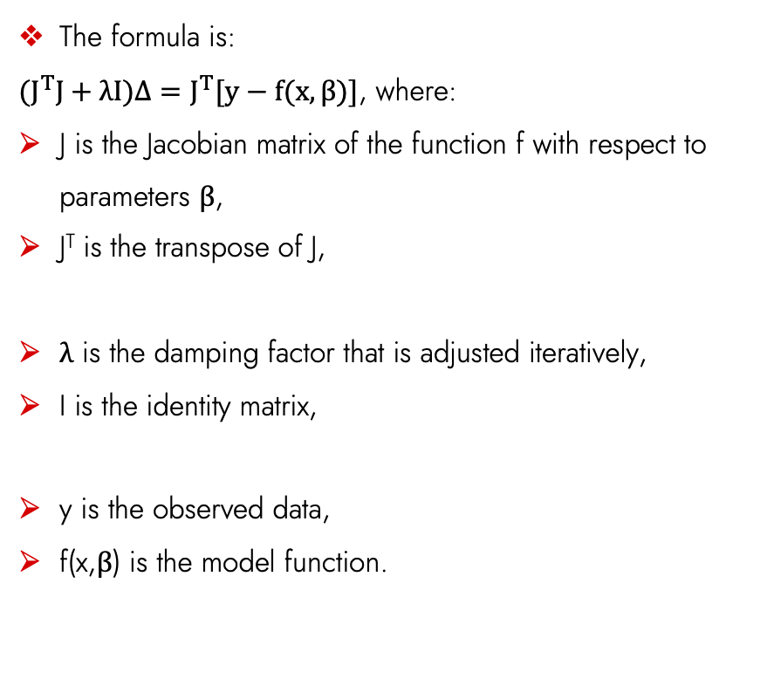
What is Levenberg-Marquardt (LM) Method?
LM is used to solve non-linear least squares problems.
It combines aspects of both the gradient descent and Gauss-Newton methods
The main advantages are:
Fast convergence
Robustness
Efficiency in small datasets
The main limitations are:
High computational time
Calibration of lambda
The formula is:
$(J^{T}J+λI)Δ=J^{T}[y−f(x,β)]$, where:
J is the Jacobian matrix of the function f with respect to parameters β,
J^{T} is the transpose of J,
λ is the damping factor that is adjusted iteratively,
I is the identity matrix,
y is the observed data,
f(x,β) is the model function.

Slide 15
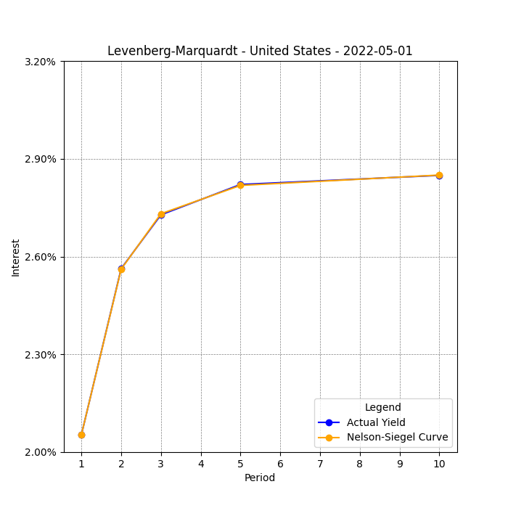
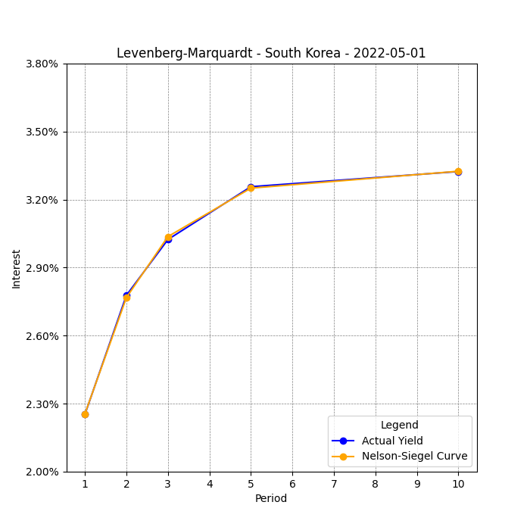
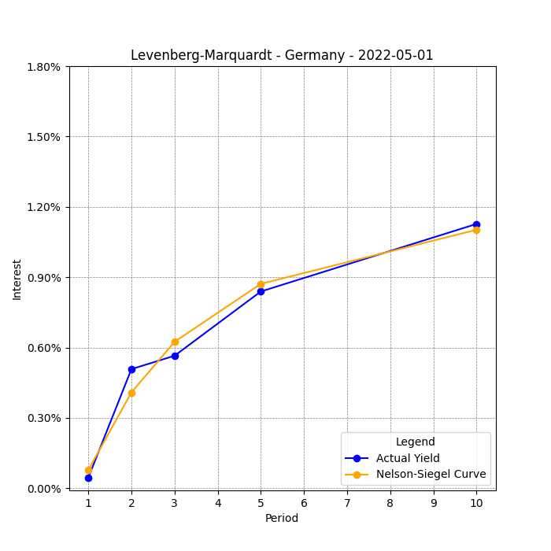
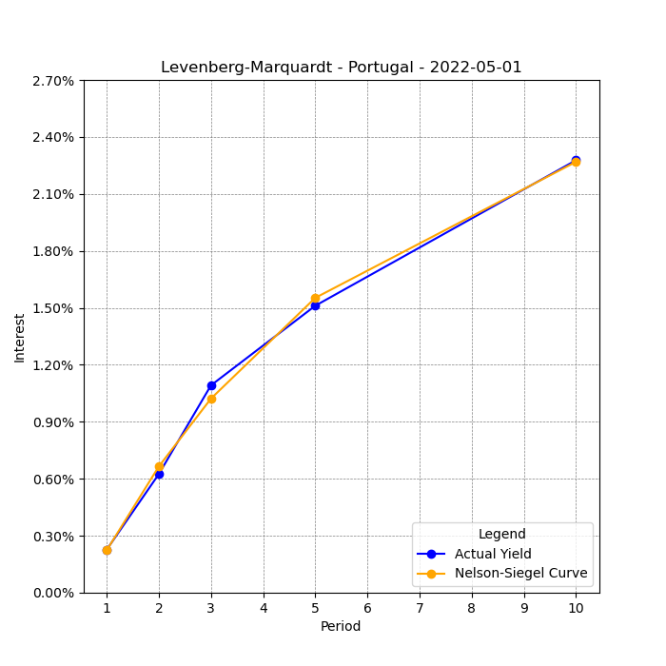


Results and Best Parameters
Demonstrates rapid convergence with high accuracy in parameter estimation.
Best parameters provide an almost perfect fit with minimal iterations.
Number of iterations is 3!
LM algorithm does not fit the data perfectly for several reasons:
Model Limitations: The underlying model may not capture all the complexities of the data. For instance, if the model is too simple (underfitting), it won't capture all the nuances of the dataset.
Local Minima: The LM algorithm, like other gradient-based optimization methods, can get stuck in local minima, especially if the error surface is not convex.

Slide 16
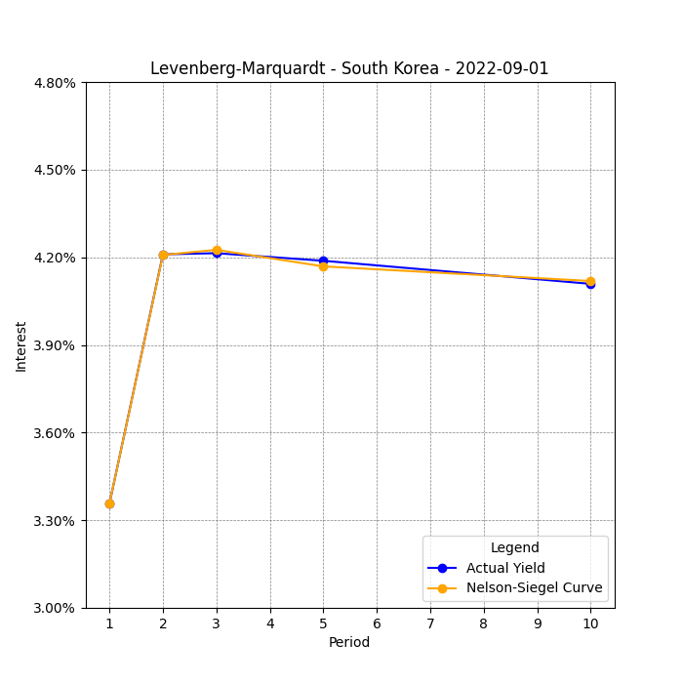
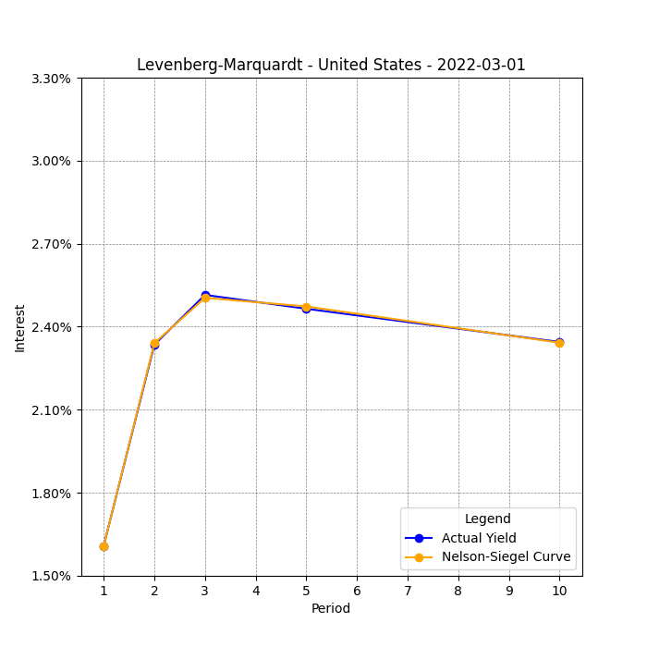
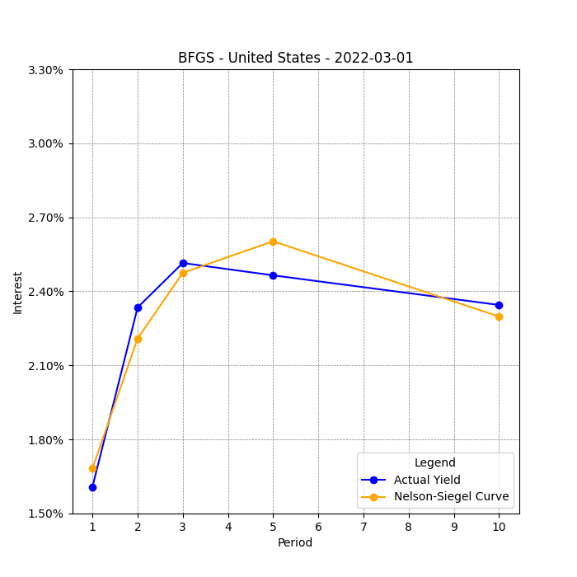
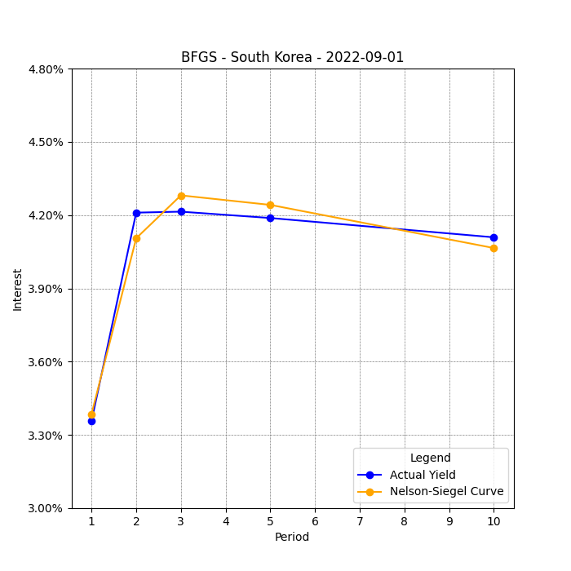


Comparison with BFGS and Newton Methods [Part I]
LM vs. BFGS:
LM and BFGS are comparable in speed, both algorithms completed the calculations in 3 iterations.
Accuracy - both LM and BFGS accurately find best betas and tau for Nelson-Siegel model for standard yield curve.
LM is favored for its robustness in varied starting conditions, especially when modelling the yield curves with non-standard shape, i.e., with higher volatility and inverse yield curve.

Slide 17
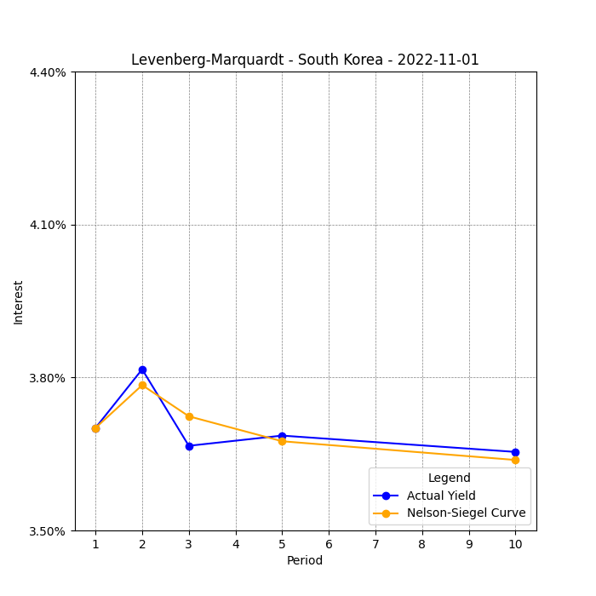
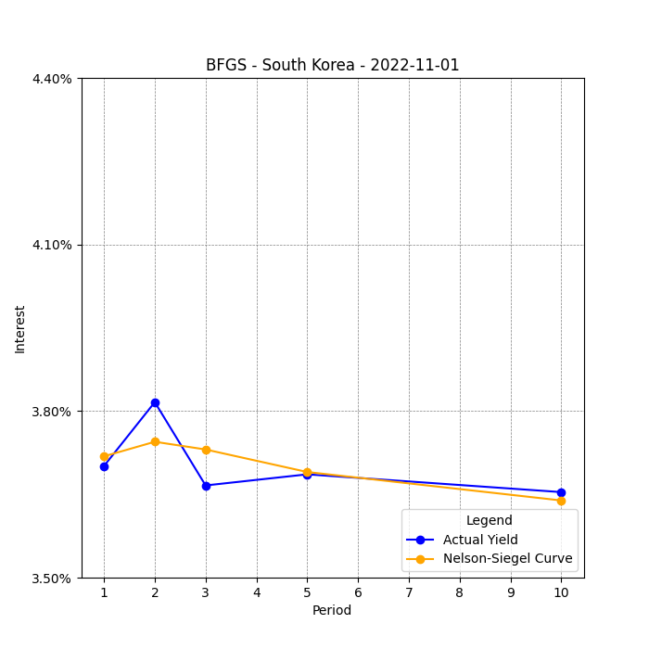
Comparison with BFGS and Newton Methods [Part II]: Devil in the details
LM tries to fit the second-year maturity as accurately as possible and after that converges in downward trend with the data.
BFGS’ graph looks more like the average between two spikes.
Even though this yield curve pattern is very hard to predict, LM showed itself to be more robust.

Slide 18
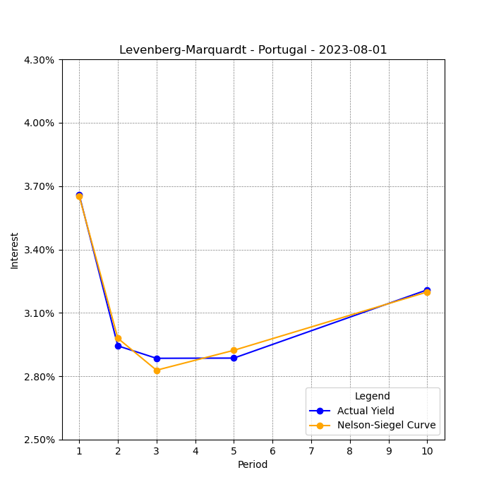
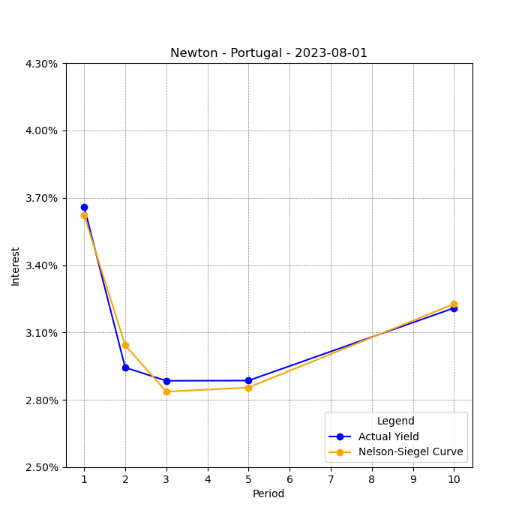
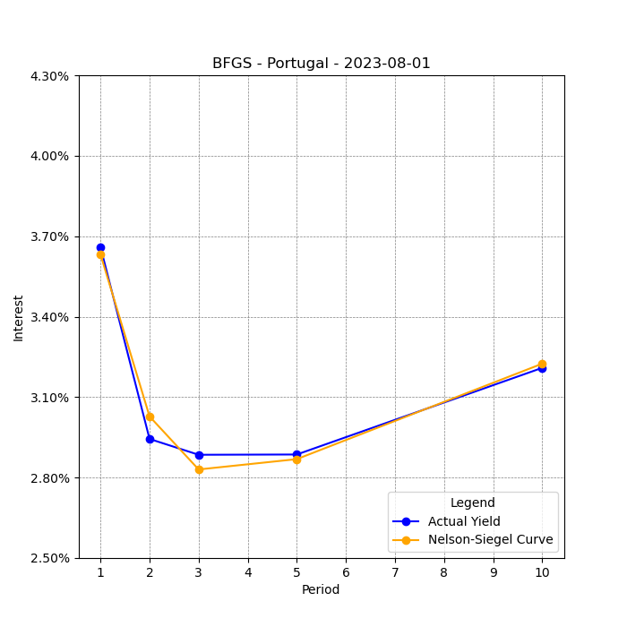
Comparison with BFGS and Newton Methods [Part III]: A little more examples
Inverted yield curve:
Three of the methods do comparatively good job modeling the inverted yield curve.
Newton Method here is limited to its speed, it took all the 100 iterations to complete the task.

Slide 19
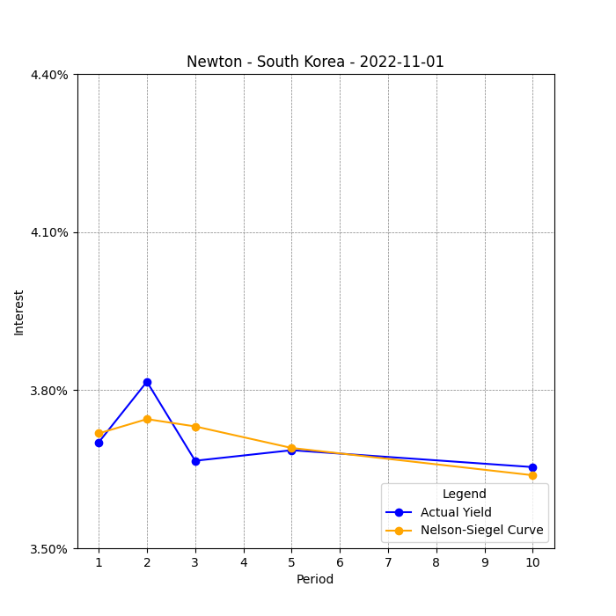
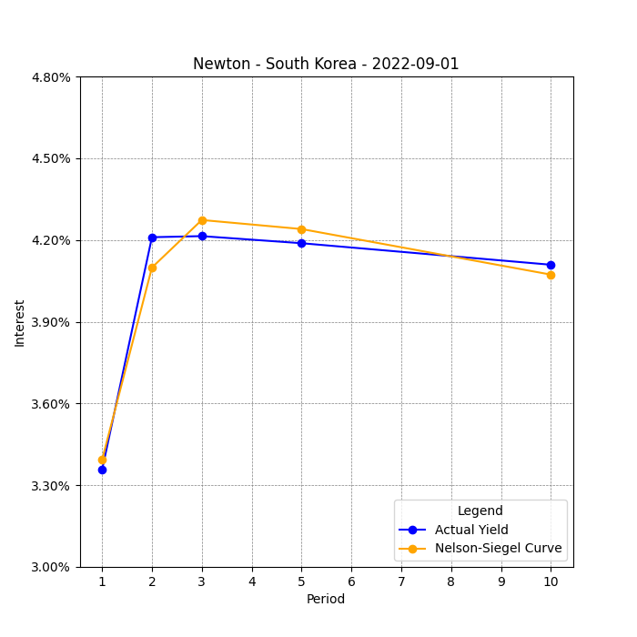
Comparison with BFGS and Newton Methods [Part IV]: Only Newton can solve this?
LM vs. Newton:
Newton converges fast if the optimal parameters chosen correctly, and yield curve has standard shape.
Newton Method can struggle to provide solutions when starting far from the final minimum.
Conclusion:
The LM method is preferred for balancing speed and accuracy, excelling with limited data or complex non-linear models.
Requires careful calibration of λ, but its ability to converge from distant starting points makes it a strong choice for non-linear least squares optimization.

Slide 20
Thanks for the attention!
Notes:
Ringrazio i presenti

